Slide 1

General Meeting 02.03.2023

Slide 2
Agenda
Review the roadmap from last time
Show some synthetic regression model results
Discussions off the bat
Correlation
Hyperparams
Thesis writing

Slide 3
February
March
April
The rest of Theory and method should be written completely.
Everything should be set for acquiring results in February.
Programming should be finished
Background chapter
Figures must be made. Or rcParams set up for result plots.
Results should be thouroughly written about in the results part.
Hereafter they will need discussion in the Discussion section.
Conclusions chapter is written
Introduction is written.
First draft ready by 31st
Revision based on feedback

Slide 4
Model testing
Created a fake regression dataset and tested out tree models and neural nets on latent representations of the data
The feature extractor is big, and the 5 decoders are comparatively small
The decoders were used to estimate error, and backpropagate to the feature extractor from different sets of initialized weights

Slide 5
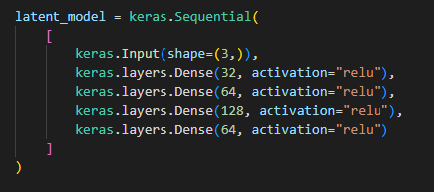
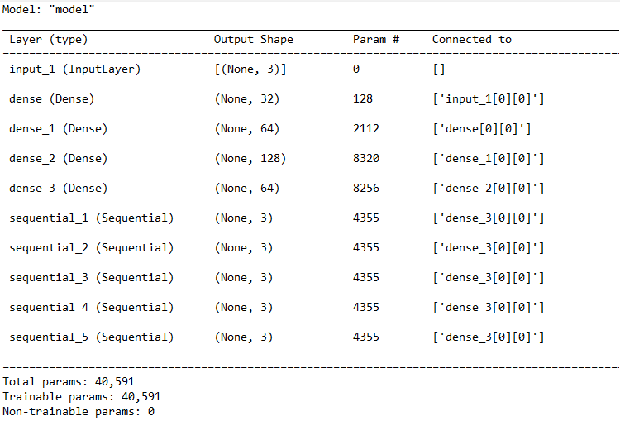
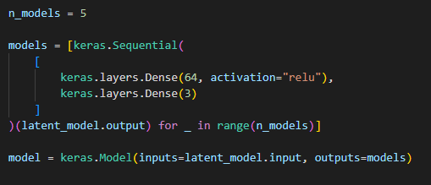
Neural Net architecture
Batch_size = 100 Epochs=1000

Slide 6
Tree models
LightGBM and Random Forest are tested on source data, and on the latent neural net representation
For TCN seismic, It will not be possible to use non latent seismic for the tree models, so this can serve as testing the viability of the method
If sufficiently viable, the question will only be on the quality of the image recognition features

Slide 7
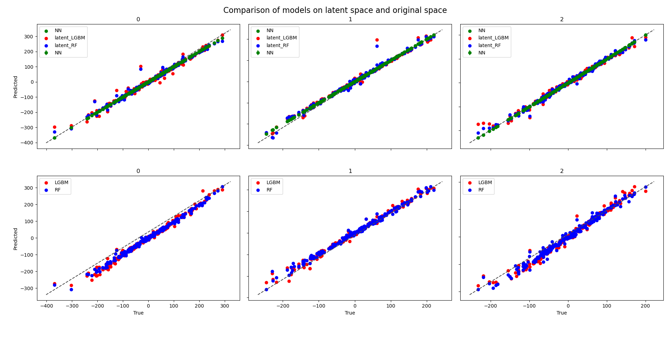
Input features = 3

Slide 8
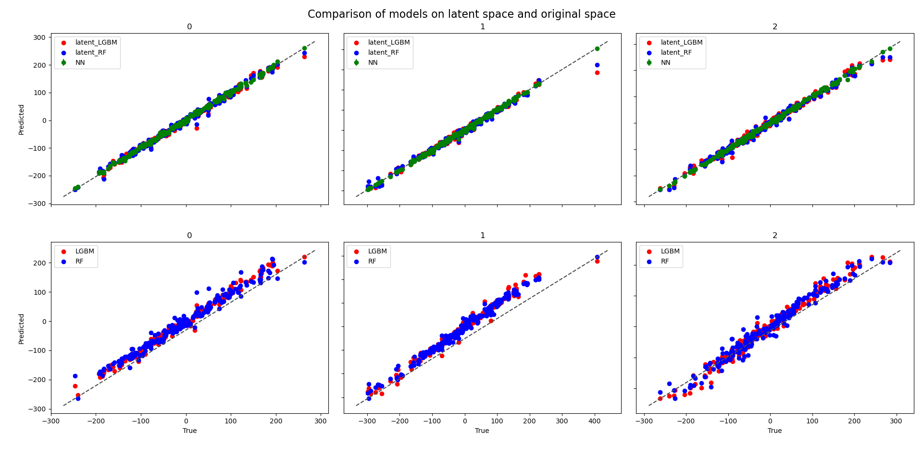
Input features = 16

Slide 9
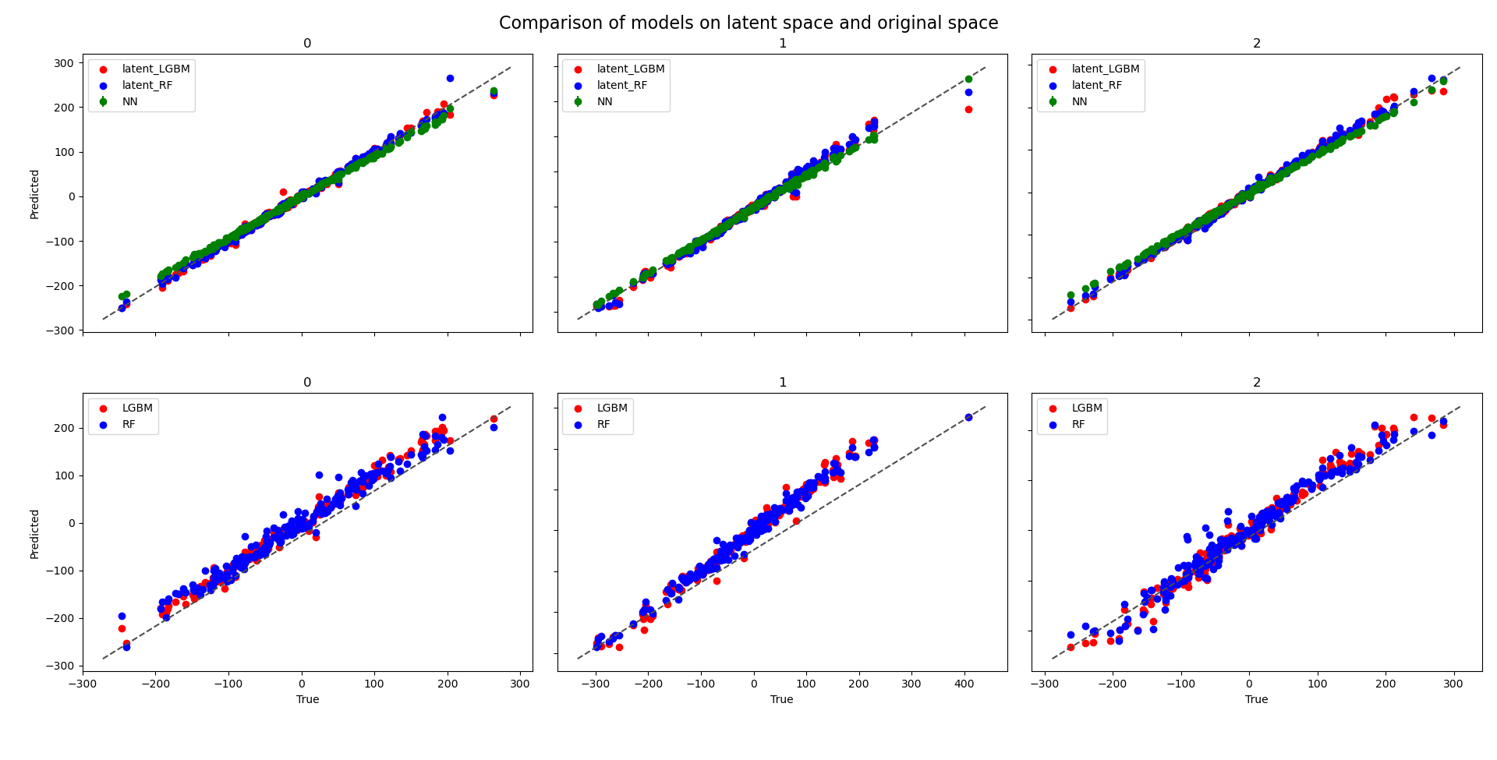
Input features = 16 & some Dropout

Slide 10
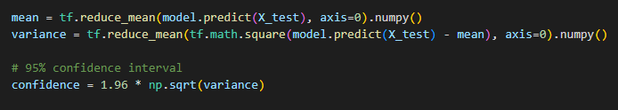
Review
The latent representation improves the prediction of the tree models in general
Reducing the bias of the tree predictors
Increasing the correlation
There are anomalous values that likely stem from overfitting to training data
ANN have better predictions, but error bars do not capture the true value
Error bars are 95% confidence interval based on the ensemble variance

Slide 11
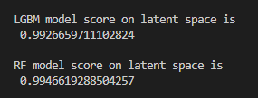
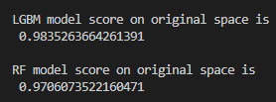
Review cont.
No measures were taken to prevent overfitting
Better generalization on the test set might happen with some dropout and quicker convergence with normalization.
Score is coefficient of determination, R^2
Which is the square of the correlation coeff

Slide 12
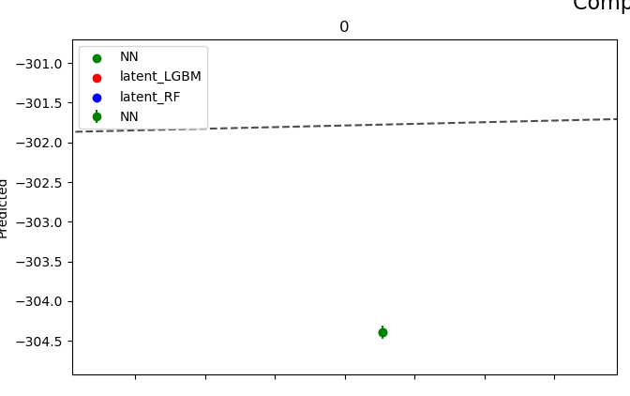
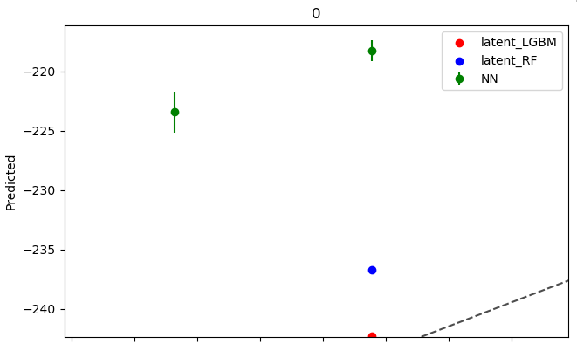
Uncertainty estimates
ANN
The ensemble method says much more about the loss landscape than it does the generalization error
Adding some dropout increased the ANN uncertainty
Tree models
Using ensambles of ensembles seems strange
Out-of-bag scores?
Dropout added

Slide 13
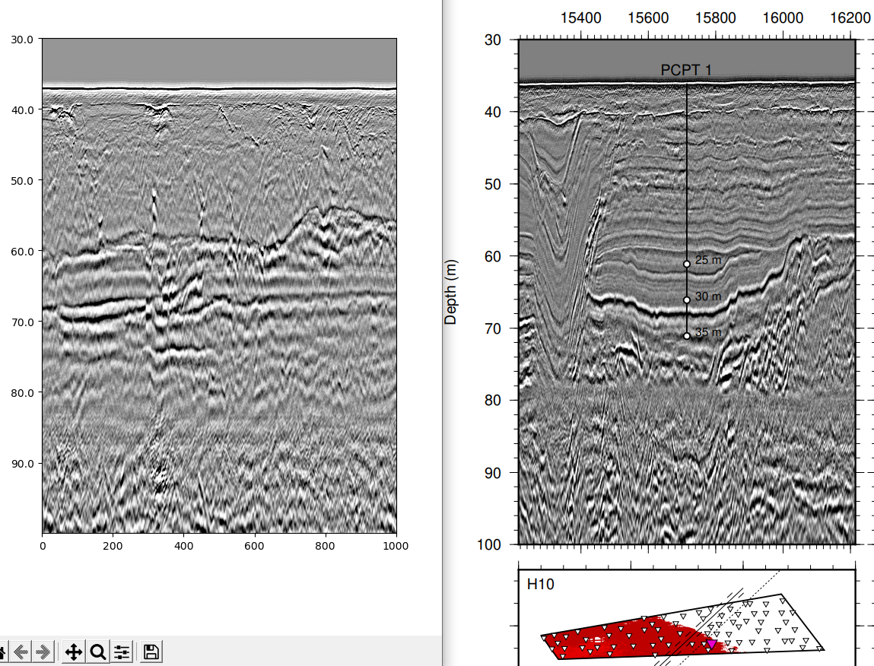
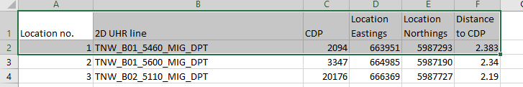
Seismic to CPT correlation
These should both be centered at well nr.1
They are both from depth 30m to 100m
Using segyio traces.samples

Slide 14
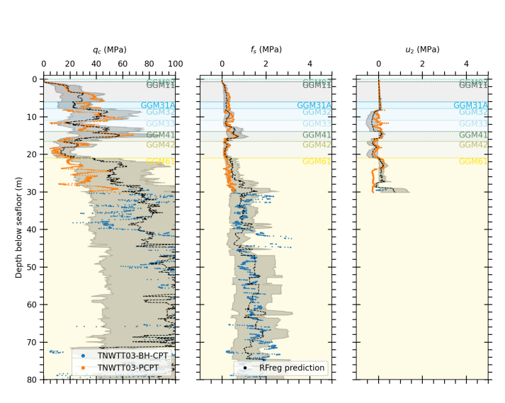
CPT
PCPT and BH-CPT
Can I just attach the one onto the other?
What about overlapping measurements?
Why is BH more often used at depth?

Slide 15
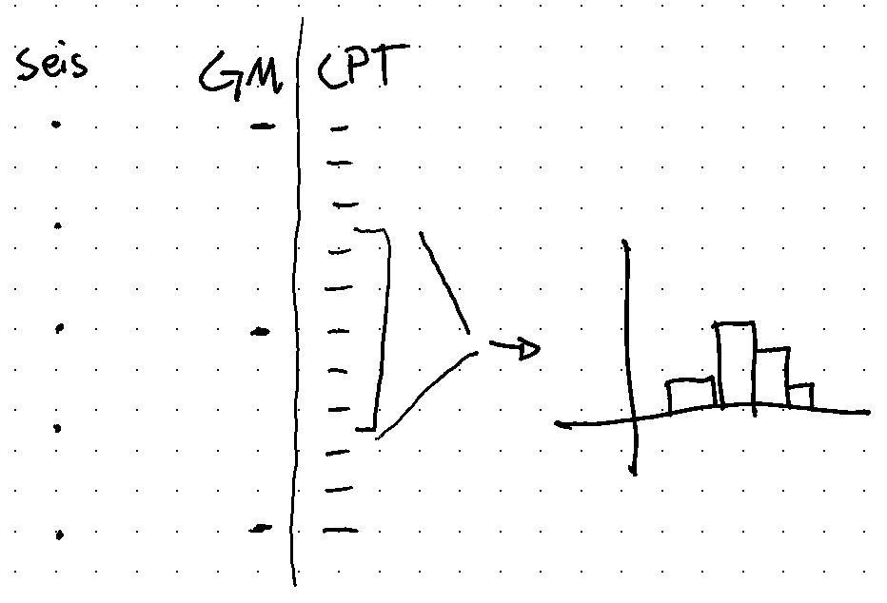
Depth correlation
Since value is needed every 0.1m, and cpt is every 0.02m we can bin by 5 samples
Possibly even 7 because of the uncertainties in the depth correlation
Bootstrapping these values can boost the ground truth data
Although the same units may then map to both strong and weak layers and confuse training?

Slide 16
Grid search Hyperparams
The hyperparameters used are not exactly specified in the IGM report – Do you have it stored?
Random forest
n_estimators = ?
max_depth = ?
…
ANN
Learning rate = ?
Activation funciton = ?
Loss function = ?
Amount and shape of Hidden layers = ?
Batch size and epochs = ?
…

Slide 17
Cross-validation
Which 5 traces shold I pick for cross-validation?
The dataset should be as complete as possible without either
What scheme should I use to decide on which wells to omit?
Should I just use the same ones as were used on TNW?

Slide 18
Feasibility evaluation
Should I include a part where I lay out the arguments on the feasibility?
Reasons to explore these methodologies for the target task – Occams razor principles
Is it reasonable that such an algorithm may catch the nonlinear relationships required
Other things along these lines I have planned for the discussion
Fewer cpt values at depth / Transition from PCPT to BH-CPT
AVO attributes represent a wider spectrum of angles near the surface
Using the ML features allows us to sidestep some assumptions like normal incidence reflection
The distance between seismic and nearest CDP

Slide 19
Method adjustments
Evolution of the method
Invert for impedance, use the encoded latent space to decode for CPT
Scrap the acoustic impedance inversion, invert for CPT directly
Tree based model trained on encoded units
RF and gradient boosted trees
Con: Train trees for every training step (slow)
Proposed now: Use a dense ANN (like Vardy, 2018), but on the encoded units
Pro: Can be trained with backpropagation along with the encoder

Slide 20
Ensemble
Ensemble of decoders?
For LightGBM this will not work, unique solutions per feature collection
Random forest has ensembles built in, no need to discuss
ANN ensemble can be trained on the same TCN encoder
Train at the same time?
Train encoder and freeze for training ANN ensemble?
Ensemble method as an uncertainty evaluation
Really just measures the texture of the loss space (uniqueness of Network solution)
Is this a desirable uncertainty estimate?
Topic for discussion part?

Slide 21
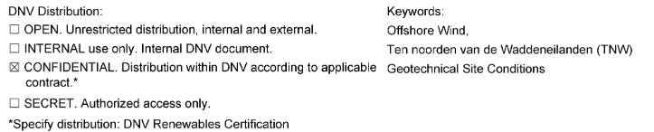
Can I cite the Reports from rVO site?

Slide 22
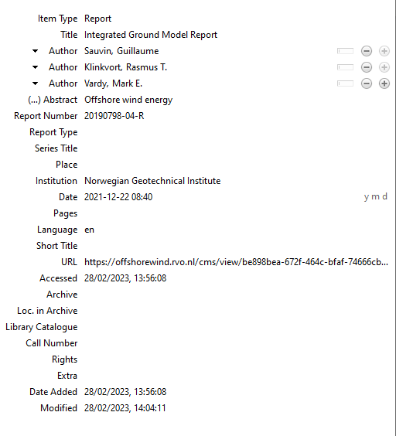

Citing the Delivered reports
Zotero
IGM Report
Who should be listed as authors?
There are no fields for Review

Slide 23
Further work
Max pooling has proved to be a good method for image recognition
I should leave this for further work
How much should I talk about further work/ideas?
Gemini field data and associated data considerations
Better depth correlation with velocity model
Unsupervised learning
Panopto segmentation
Self-attention mechanisms
Recurrent NN encoder
NLP integration – Discuss the field survey with your model
GPTs may be used for this
LSTM

Slide 24
Increased Frequency of meetings
From this week on there will be meetings every other week
These will be on odd numbered week thursdays at 9.30
Is this a good time?
Next meeting: 16.03.2023
Agenda
Update on progress
Review road map
Discussion

